Slide 1




NEXT GEN EMPLOYABILITY PROGRAM
Creating a future-ready workforce
Team Members
College Name
Student Name : Ranjith S
Student ID : 623521104045
6235 - AVS College of Technology

Slide 2

CAPSTONE PROJECT SHOWCASE
Project Title
Building Bus Reservation System using Python and Django
Abstract | Problem Statement | Project Overview | Proposed Solution | Technology Used | Modelling & Results | Conclusion

Slide 3
Abstract
The Bus Reservation System (BRS) is a web-based application developed using Python and Django framework.
Aimed at facilitating the booking and management of bus tickets, providing convenience and efficiency to users.
Key features include user registration/authentication, bus and route management, seat reservation, payment integration, and reservation management.
Source :

Slide 4
Problem Statement
Existing bus reservation systems suffer from inefficiency and lack of convenience, posing challenges for both passengers and bus operators.
Booking processes are often complex and time-consuming, leading to inconvenience for passengers and potential loss of business for operators.
Passengers face difficulty in accessing accurate and up-to-date information about available buses, routes, and seat availability, hindering effective travel planning.
Source :

Slide 5
Project Overview
The Bus Reservation System (BRS) is a web-based application developed using Python and Django framework, aiming to streamline the booking process and enhance the management of bus reservations. Here's an overview of the project:
Objective: The primary goal of the project is to create a user-friendly and efficient platform for booking bus tickets, providing accurate information to passengers, and empowering bus operators with effective management tools.
Source :

Slide 6
Proposed Solution
Develop a comprehensive Bus Reservation System (BRS) using Python and Django framework to streamline the booking process and enhance reservation management.
Key Components:
User Management
Bus and Route Management
Seat Reservation
Payment Integration
Reservation Management
Admin Dashboard
Source :

Slide 7
Development Process:
Adopt Agile methodologies with iterative cycles for requirements gathering, design, implementation, testing, and deployment.
Utilize project management tools such as Jira or Trello to track progress and manage tasks efficiently.
Conduct regular code reviews and testing to ensure code quality and reliability.
Source :

Slide 8


Technology Used
Front-end
Back-end
Source :

Slide 9
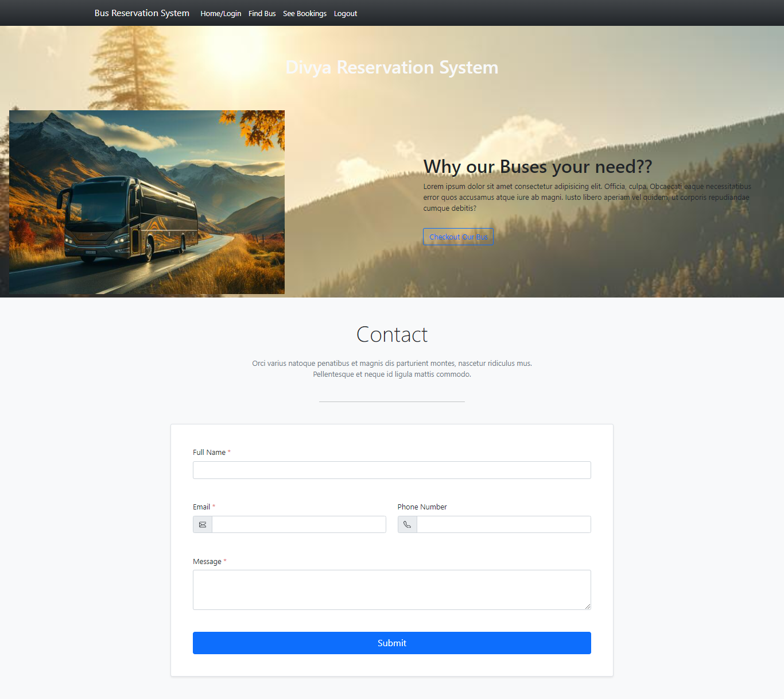
Modelling & Results
Source :

Slide 10
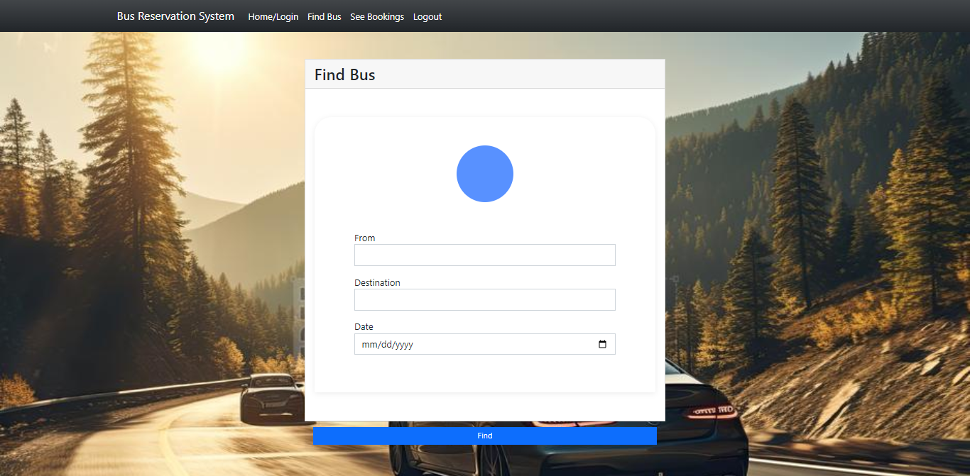
FIND BUS

Slide 11
HOME PAGE

Slide 12
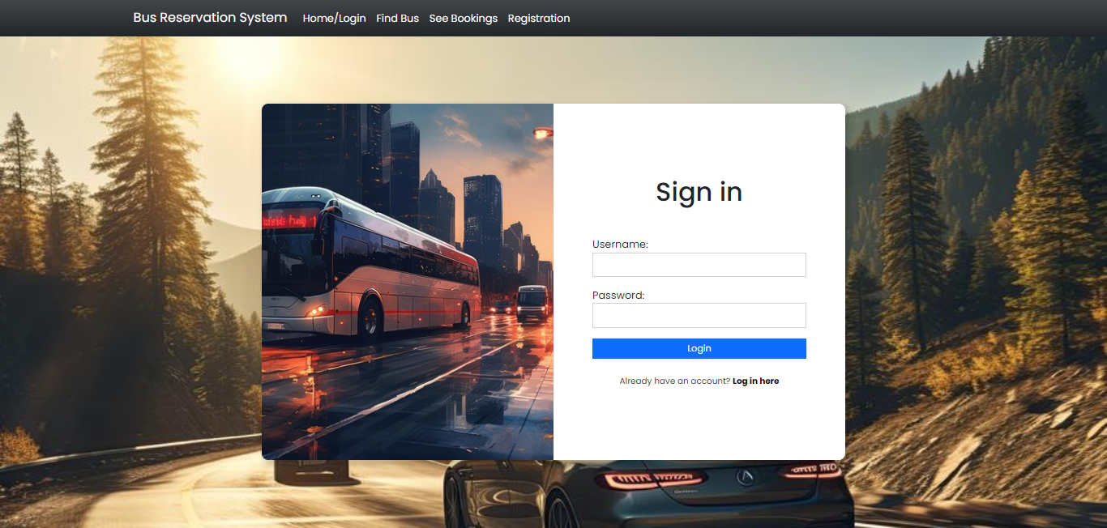
LOGIN PAGE

Slide 13
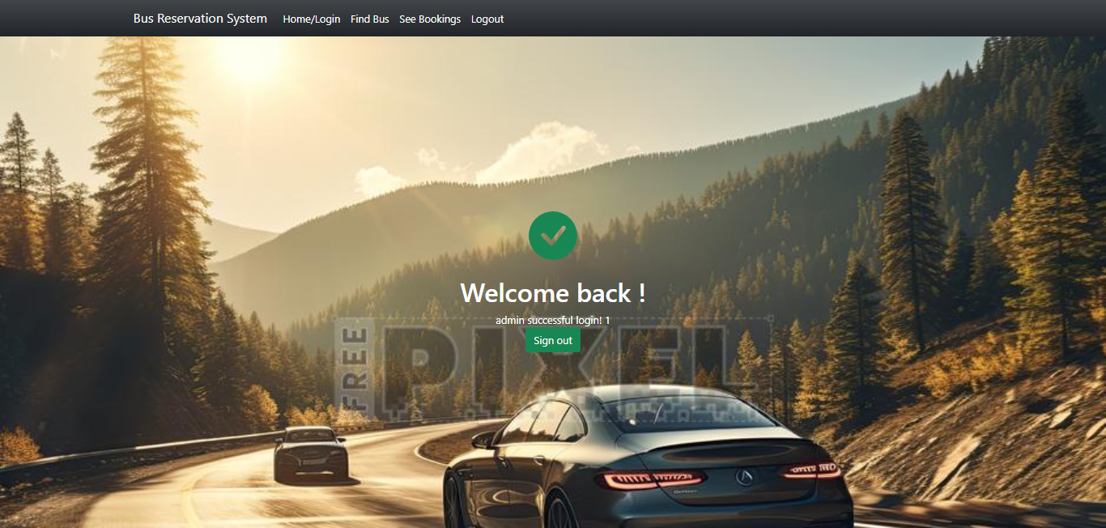
THANKS PAGE

Slide 14
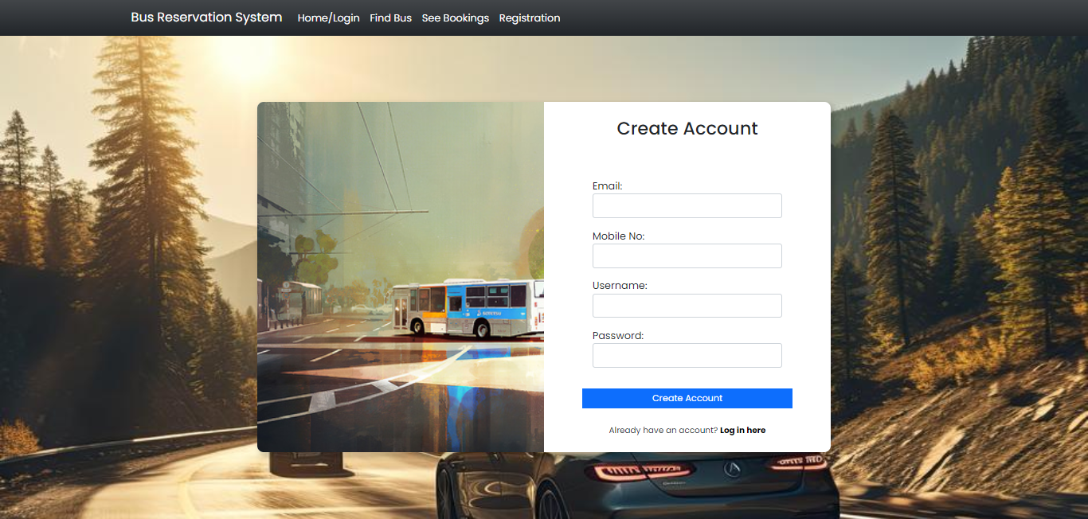
Registration PAGE

Slide 15
Future Enhancements:
Develop a dedicated mobile application for bus ticket booking.
Integrate real-time updates for bus schedules and seat availability.
Enhance the admin dashboard with advanced analytics tools.
Implement dynamic pricing algorithms based on demand.
Enable support for multiple languages.

Slide 16
Conclusion
In conclusion, the proposed Bus Reservation System (BRS) offers a comprehensive solution for efficient bus ticket booking and management. By leveraging Python and Django framework, the system streamlines the booking process, enhances reservation management, and provides a seamless experience for both passengers and bus operators.
Source :

Slide 17
Thank You!
Notes:
Thank You !!

